Slide 1

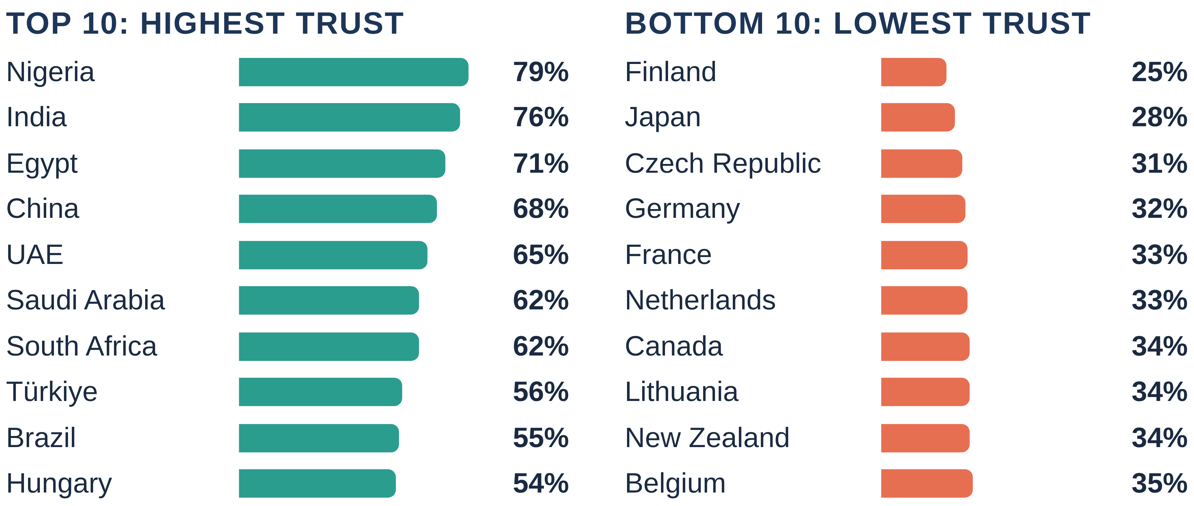
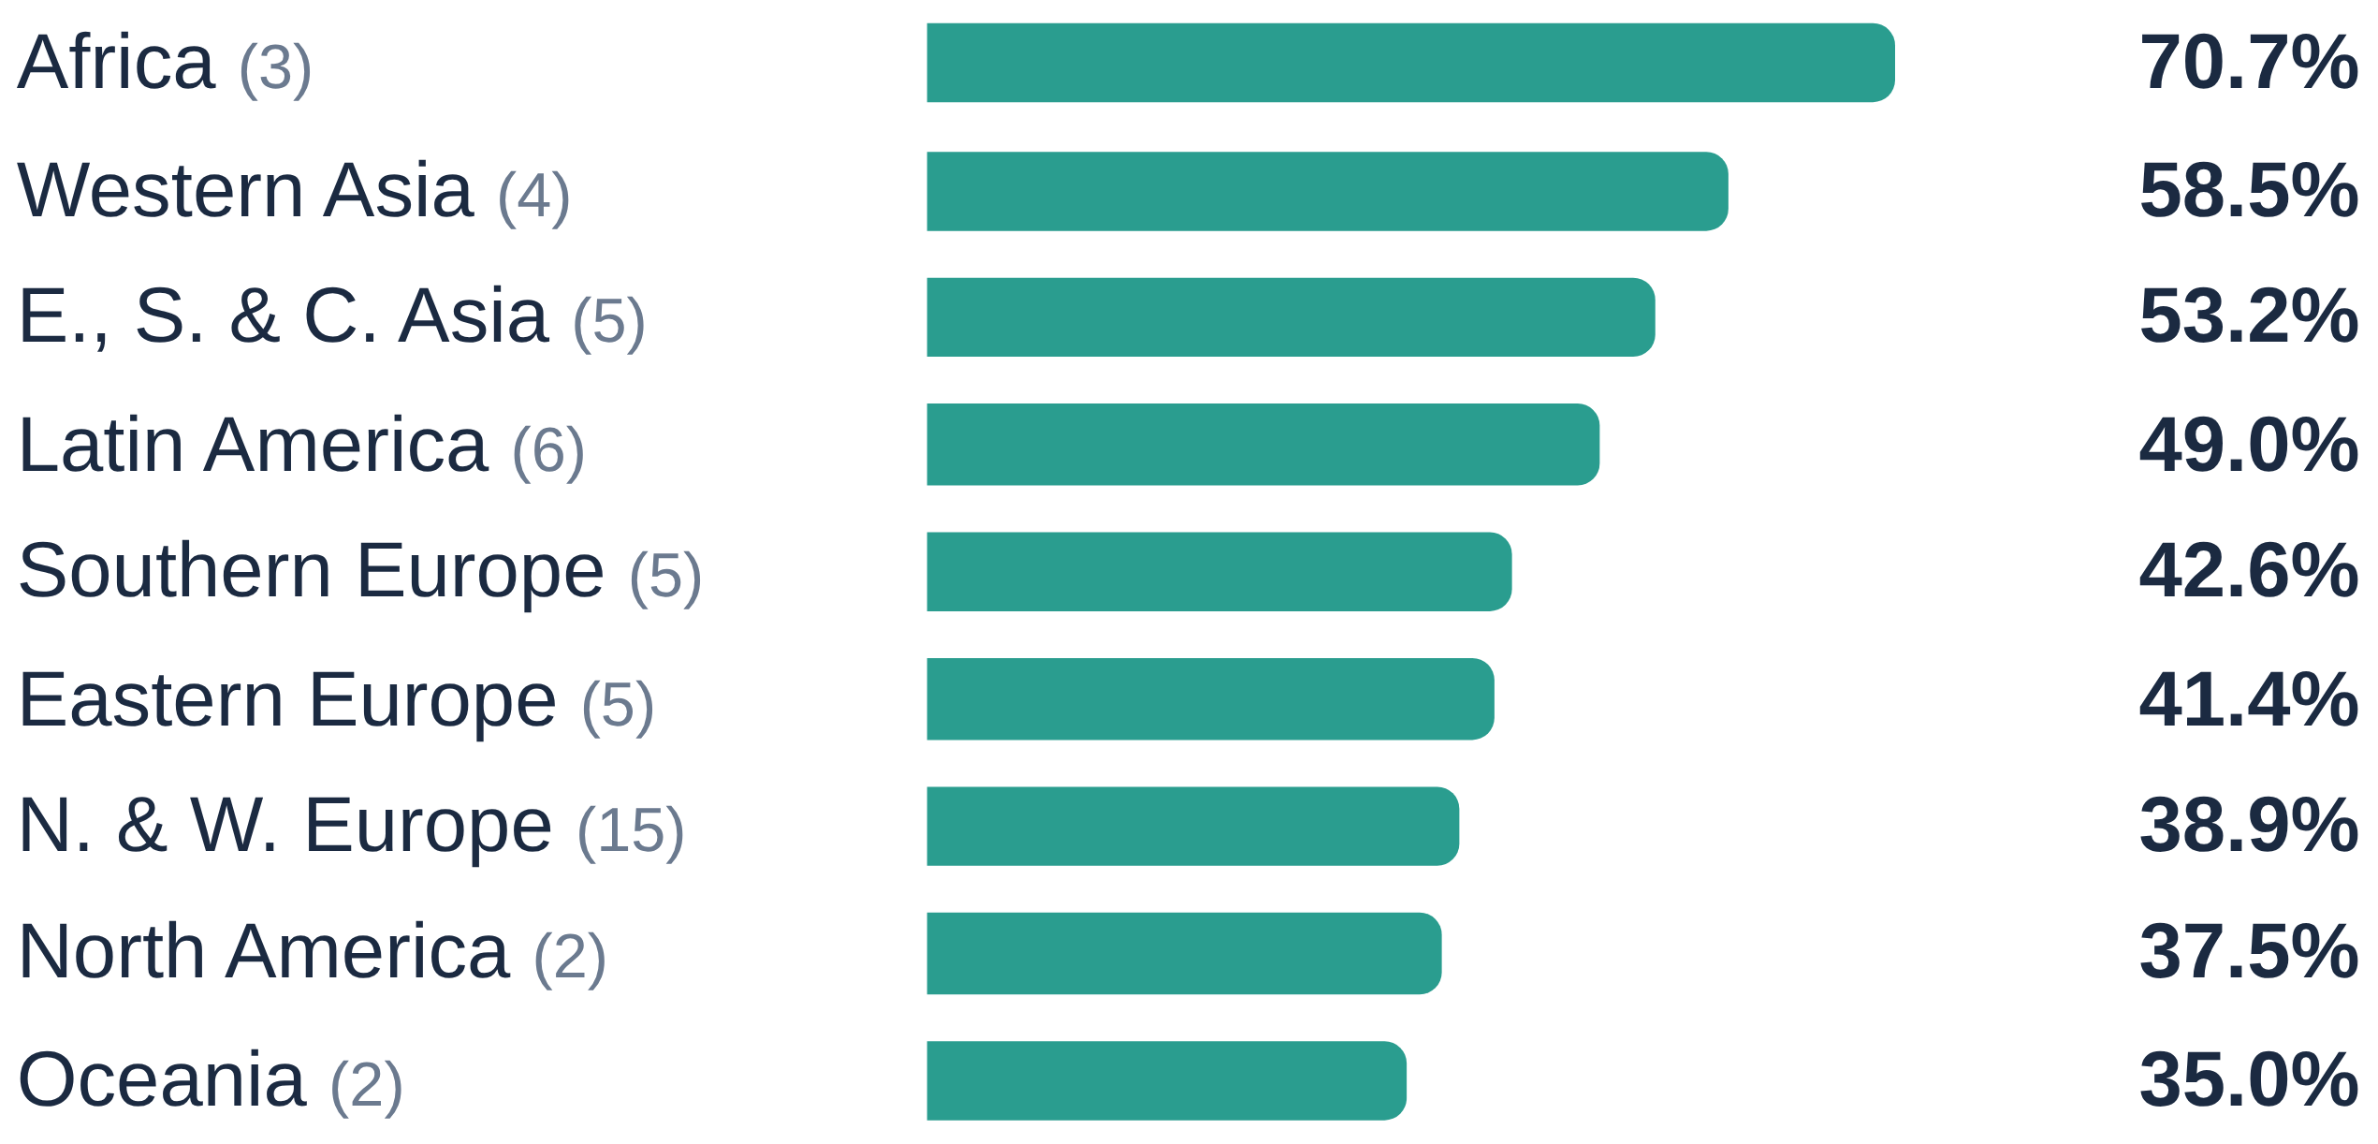
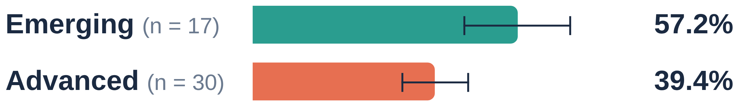
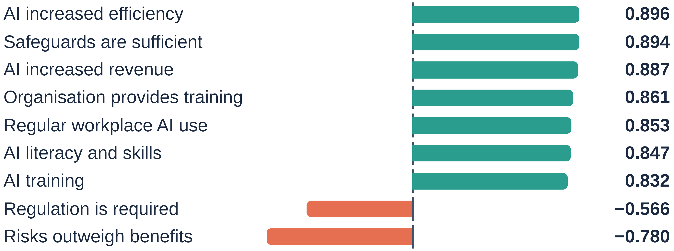
AN6002 Analytics and Machine Learning in Business
Section A, Group 4
Ang Wei Hao Welthan · Felda Everyl · Guo Yutong
Kaitwatcharachai Onnicha · Joanne Quek
Global AI Trust and Attitudes
What drives public trust in AI across 47 countries, and can we predict it?
Why calibrated trust matters
AI increasingly shapes everyday decisions. When trust is too low, useful systems are avoided; when it is too high, errors go unchallenged. The practical aim is calibrated trust: reliance that reflects what an AI system can reliably do, with awareness of when its output must be questioned. We examine global AI trust through country comparisons, statistical relationships and supervised regression, guided by four questions.
Q1 · Where
How does trust in AI differ across countries and regions?
Q2 · What
What factors seem to be related to AI trust?
Q3 · Predict
Can we predict AI trust from these factors?
Q4 · Trend
Is public perception of AI becoming more positive?
Data at a glance
47
43
0
25–79%
30
countries in the main dataset; one row per country, not per respondent
variables: trust, acceptance, benefits, risks, literacy, training, adoption, GDP
missing values, duplicate rows or duplicate countries in the main dataset
range of the outcome: share of people who trust AI
countries with both years (2023 and 2024) in a separate benefit-perception dataset
Caveat · Means and medians weight each country equally: summaries of the countries studied, not population-weighted world estimates.
Q1
How does trust in AI differ across countries and regions?
Trust varies widely between countries
MEAN TRUST BY REGION² (n countries)
Share of people who trust AI (%), bars on a common 0–80% scale.
EMERGING VS ADVANCED ECONOMIES¹ (mean, whisker = ±1 SD)
79% Nigeria vs 25% Finland: a 54-point gap between the most and least trusting countries.
India (76%) and Japan (28%) are next at each end, so the extremes are not one-off outliers.
Emerging economies trust AI 17.8 pp more on average but vary more. Mann–Whitney U = 45.5, p < 0.001.
Caveat · ¹ Group differences do not show that economic development causes trust.
² Several regions hold only 2–3 countries, and E., S. & C. Asia spans 28–76%.
Q2
What factors seem to be related to AI trust?
Trust travels with usefulness and protection
PEARSON CORRELATION WITH TRUST (47 COUNTRIES)
Benefits matter: expected and experienced benefits correlate with trust (Spearman ρ = 0.692 and 0.739).
Richer countries trust less: GDP per capita ρ = −0.514, consistent with the advanced-economy gap.
Weak evidence for concerns: worry about negative impacts has r = −0.324 but ρ = −0.162 (not significant after multiple-testing correction); election, misinformation and top-risk concerns are also not significant.
Accepting AI ≠ trusting AI. Acceptance exceeds trust across countries. Lithuania: 76% accept, 34% trust. (Country-level data cannot show whether the same individuals hold both views.)
Caveat · Correlation is not causation and may run both ways: trusting AI may also encourage use or make safeguards look adequate.
2026 T1
AN6002 Analytics and Machine Learning in Business
Notes:
Implementing sentiment analysis: flow chart?
Drawbacks: Pie chart?
Results: Line/Bar chart?
SCRAPE TWITTER BEAUTIFUL SOUP
Proposed model, financial events studied, discussion.

Slide 2
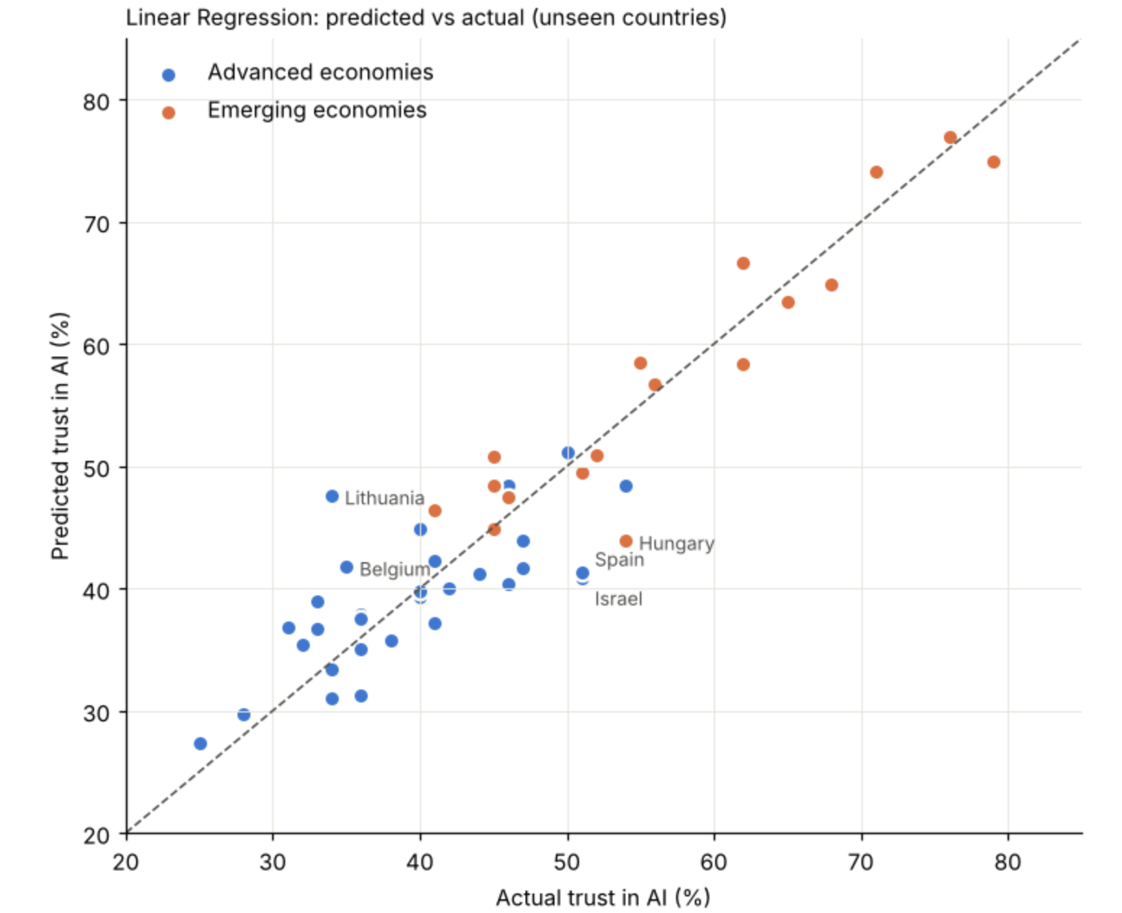
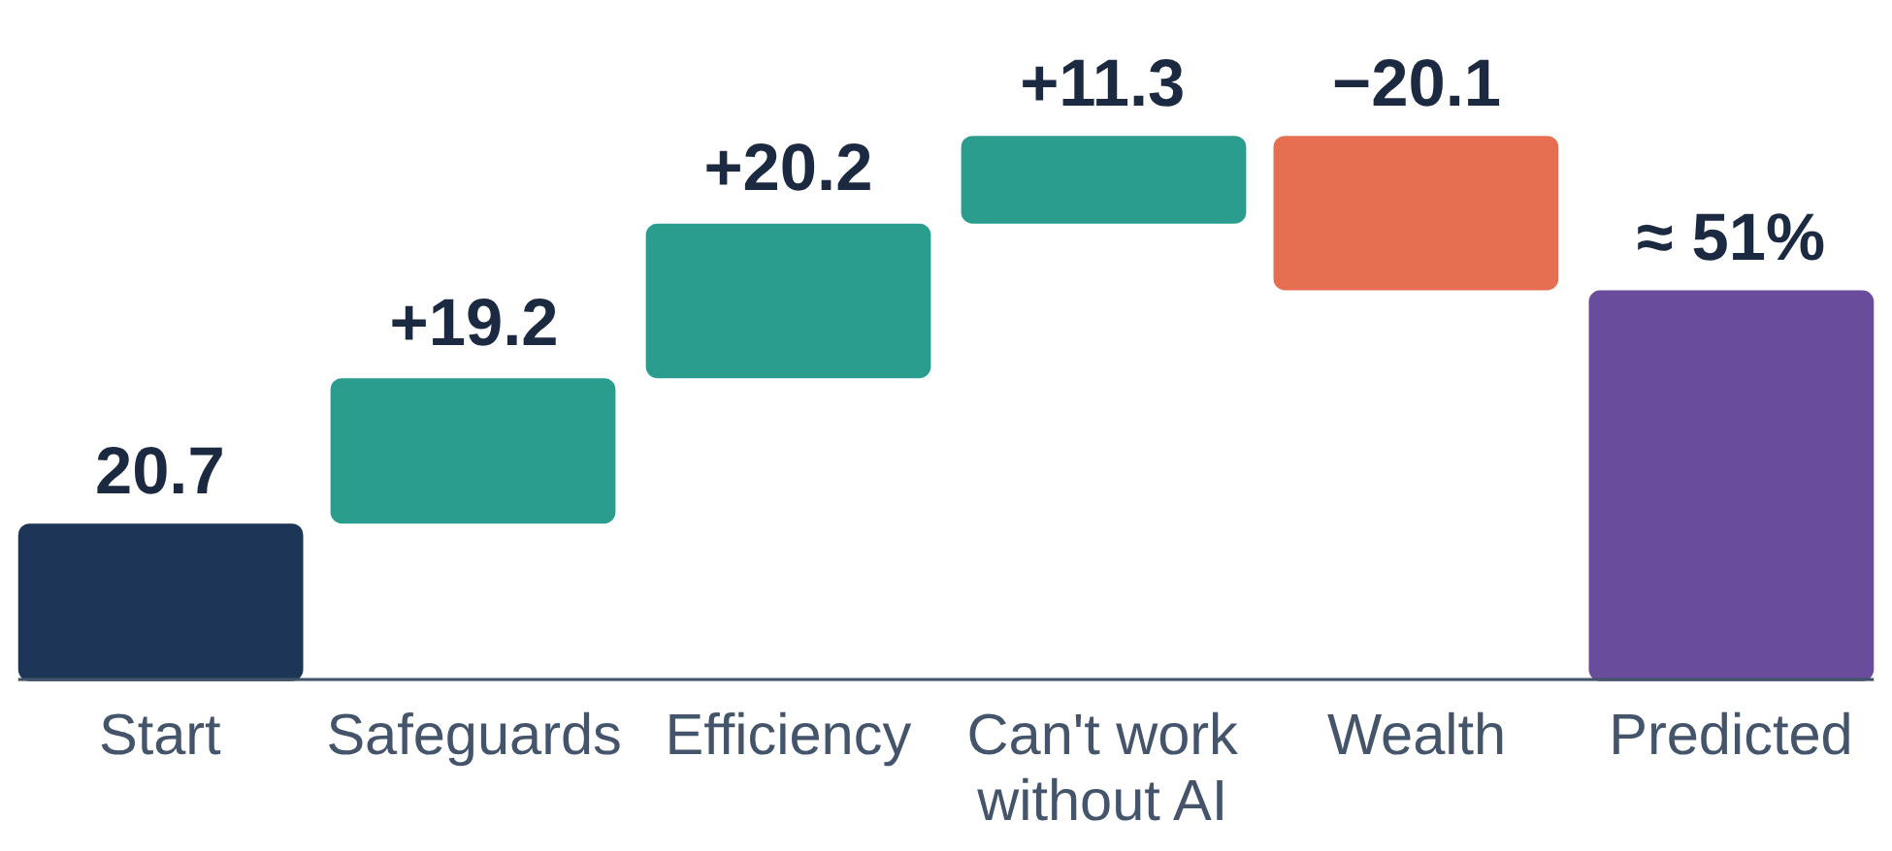
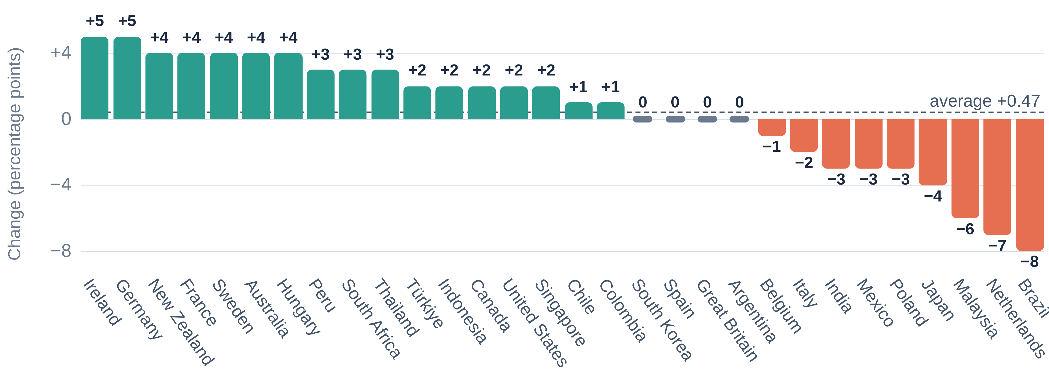
AN6002 Analytics and Machine Learning in Business
Section A, Group 4
Ang Wei Hao Welthan · Felda Everyl · Guo Yutong
Kaitwatcharachai Onnicha · Joanne Quek
Global AI Trust and Attitudes
Prediction, trend and implications
Q3
Can we predict AI trust from these factors?
Step 1: 36 overlapping candidates → 4 inputs
1) 36 candidates
Median |ρ| between inputs 0.52; 53% of pairs ≥ 0.5.
2) Cluster
Hierarchical, |Spearman ρ|, threshold 0.25 → 15 groups.
3) Pass ≥ 3 of 4 tests
Correlation · Mutual info · Bootstrap Lasso (200) · Random forest importance.
4) 4 final inputs
Safeguards ρ = 0.83 · Workplace efficiency 0.82 · Can't work w/o AI 0.72 · ln(GDP) −0.51 (all p < 0.001); Max VIF 5.1 (previously 167).
Q3
Can we predict AI trust from these factors? (continued)
Step 2: 4 inputs predict trust within ~3.7 pp
REPEATED 5-FOLD CV (3 SHUFFLES, NESTED TUNING)
Model | MAE (pp) | RMSE (pp) | R² | Within ±5 pp
Baseline (mean) | 9.86 | 12.59 | −0.04 | 29%
Linear regression ✓ | 3.66 | 4.68 | 0.86 | 73%
Ridge regression | 3.67 | 4.64 | 0.86 | 71%
Random forest | 4.35 | 5.40 | 0.81 | 65%
Decision tree | 5.91 | 6.95 | 0.68 | 43%
Tuning changed MAE by < 0.1 pp; a single 70/30 split ranged 2.17–5.29 pp vs 3.49–3.82 pp under repeated CV.
WHAT GOES WITH HIGHER TRUST IN AI?
Model: Trust = 20.7 + 0.37*Safeguards + 0.31*Efficiency + 0.25*CantWorkWithoutAI − 1.75*ln(GDP)
Example, Singapore:
Start: 20.7
Safeguards are enough: 52% × 0.37 = +19.2
AI made work more efficient: 65% × 0.31 = +20.2
Can't work without AI: 45% × 0.25 = +11.3
Wealth: ln(GDP) 11.5 × −1.75 = −20.1
Predicted trust ≈ 51% (actual: 50%)
Predicted vs actual trust for countries the model had not seen.
Higher safeguards, efficiency and reliance on AI push trust up; higher wealth pulls it down.
35 of 47 countries within ±5 pp; 8 within 5–8 pp; 4 larger. Over-predicted: Lithuania (34% vs 47.6%). Under-predicted: Israel (51 vs 40.8), Hungary (54 vs 43.9), Spain (51 vs 41.3).
Caveat · Likely optimistic: inputs were selected using all 47 countries before evaluation. Coefficients are associations, not policy effects. An in-fold-selection Ridge benchmark gives R² 0.73,
RMSE 5.0 (vs 0.78, 4.4 with fixed inputs).
Q4
Is public perception of AI becoming more positive?
Leans positive, but no proven shift
Change in % who say AI’s benefits outweigh its drawbacks, 2023 → 2024
Share saying AI benefits outweigh drawbacks, 30 countries with both years:
54.1% → 54.6% (basically flat)
Mean change +0.47 pp, median +1.50 pp. 17 up · 9 down · 4 unchanged.
Largest rises: Germany, Ireland (+5). Largest falls: Brazil (−8), Netherlands (−7), Malaysia (−6).
No real shift: the change is small enough to be just chance. (Wilcoxon p = 0.36; t-test p = 0.48)
Caveat · Measures benefit perception, not trust; two years only; China and Switzerland excluded (no 2023 value).
30 countries with data for both years. Bars show the change in percentage points (pp).
Implications for calibrated trust
Explain clearly
Communicate capabilities and protections, backed by reliability checks and clear limits.
Build judgement
Higher-trust countries report more problematic AI use (r = +0.614): teach when to question AI.
Stay accountable
Let users challenge outputs and assign clear responsibility; never stereotype by national score.
Limitations
47 countries, one snapshot
Country-level only
Self-reported
Correlated inputs
Not causal
Trend: 2 years
The goal is not more trust in AI, but the right amount: informed reliance that keeps human judgement and clear responsibility in the loop.
2026 T1
AN6002 Analytics and Machine Learning in Business
Notes:
Implementing sentiment analysis: flow chart?
Drawbacks: Pie chart?
Results: Line/Bar chart?
SCRAPE TWITTER BEAUTIFUL SOUP
Proposed model, financial events studied, discussion.

